Slide 1
I’ve been coloured in by: …………………………

Slide 2
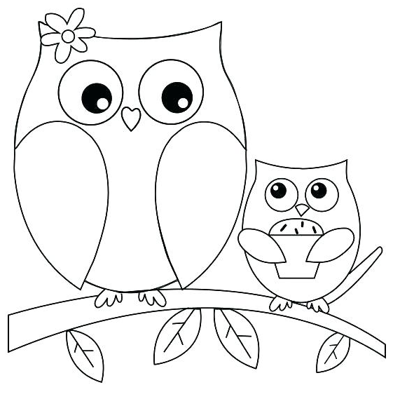
I’ve been coloured in by: …………………………

Slide 3
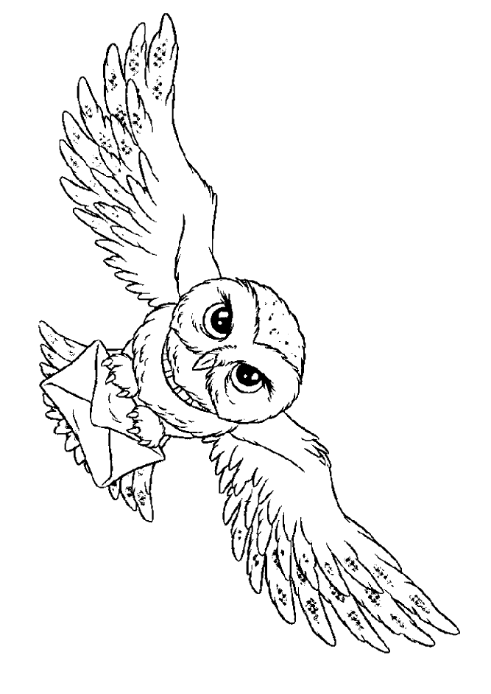
I’ve been coloured in by: …………………………

